Slide 1

Eagle Mt.-Saginaw
Independent
School District
2Q22
Demographic Report

Slide 2
Local Economic Conditions

Slide 3
DFW New Home Starts & Closings are Flattening Out
Key Trends
Starts: +9% YOY / -1% QOQ
Closings: -3% YOY / -4% QOQ
Starts Exceed Closings by 10,600 Homes!
54,300
43,700
Source: Zonda
Notes:
New home starts are up 9% YOY, but are down 1% QOQ.
This flattening out was expected given sales caps that were in place, lot supply constraints, and cycle times.
Starts and closings are typically well aligned.
With elongated build times, the gap between starts and closings is the widest on record.

Slide 4
Interest Rates – Monthly Payment Comparison
Since January 2022
Mortgage Rates up ~66%
Base Prices up 7%
Monthly
Payment
up $529
(~28%)
January Monthly Payment
3.5% Interest Rate and $343,221 Median Base Price: $1,905
June Monthly Payment
5.8% Interest Rate and $365,700 Median Base Price: $2,434

Slide 5
District New Home Starts and Closings
Starts | 2016 | 2017 | 2018 | 2019 | 2020 | 2021 | 2022 |  | Closings | 2016 | 2017 | 2018 | 2019 | 2020 | 2021 | 2022
1Q | 177 | 179 | 389 | 351 | 530 | 321 | 319 |  | 1Q | 189 | 154 | 295 | 285 | 340 | 473 | 162
2Q | 223 | 368 | 411 | 439 | 593 | 356 | 420 |  | 2Q | 227 | 204 | 310 | 483 | 567 | 425 | 262
3Q | 243 | 412 | 293 | 442 | 514 | 318 |  |  | 3Q | 265 | 243 | 374 | 512 | 664 | 300
4Q | 124 | 224 | 517 | 401 | 580 | 199 |  |  | 4Q | 175 | 324 | 367 | 441 | 591 | 264
Total | 767 | 1,183 | 1,610 | 1,633 | 2,217 | 1,194 | 739 |  | Total | 856 | 925 | 1,346 | 1,721 | 2,162 | 1,462 | 424

Slide 6
1 Year Change in District Housing
 | 2Q21 | 2Q22 | Difference
Annual Starts | 1,771 | 1,225 | -546
Quarterly Starts | 357 | 420 | +63
Annual Closings | 2,153 | 987 | -1,166
Quarterly Closings | 425 | 262 | -163
Under Construction | 504 | 708 | +204
Inventory | 582 | 820 | +238
VDL | 990 | 2,277 | +1,287
Futures | 19,227 | 17,932 | -1,295

Slide 7
DFW New Home Ranking Report
ISD Ranked by Annual Closings – 2Q22
Rank | District Name | Annual Starts | Annual Closings | Inventory | VDL | Futures
1 | NORTHWEST ISD | 4,519 | 3,608 | 2,508 | 3,040 | 38,878
2 | DENTON ISD | 2,817 | 2,753 | 2,160 | 3,124 | 31,273
3 | FORNEY ISD | 2,484 | 2,712 | 1,109 | 2,412 | 30,175
4 | PROSPER ISD | 2,844 | 2,630 | 2,323 | 3,032 | 21,195
5 | FRISCO ISD | 1,590 | 1,799 | 1,291 | 1,339 | 9,749
6 | DALLAS ISD | 2,031 | 1,614 | 1,834 | 2,128 | 6,257
7 | PRINCETON ISD | 2,434 | 1,557 | 1,609 | 1,826 | 9,571
8 | ROYSE CITY ISD | 1,812 | 1,312 | 1,348 | 1,929 | 8,515
9 | MIDLOTHIAN ISD | 1,341 | 1,157 | 916 | 1,037 | 20,949
10 | CROWLEY ISD | 1,334 | 1,154 | 796 | 2,130 | 16,373
11 | CRANDALL ISD | 1,486 | 1,138 | 890 | 1,021 | 13,856
12 | WAXAHACHIE ISD | 1,030 | 1,072 | 540 | 1,172 | 26,958
13 | LEWISVILLE ISD | 1,242 | 1,015 | 989 | 1,208 | 2,504
14 | EAGLE MT-SAGINAW ISD* | 1,225 | 987 | 820 | 2,277 | 17,932
15 | ROCKWALL ISD | 1,411 | 942 | 1,214 | 2,369 | 8,989
16 | MCKINNEY ISD | 1,146 | 940 | 883 | 1,512 | 14,761
17 | ANNA ISD | 1,164 | 913 | 732 | 880 | 7,162
18 | CELINA ISD | 1,330 | 880 | 1,035 | 765 | 33,549
19 | AUBREY ISD | 1,590 | 841 | 1,154 | 680 | 5,737
20 | COMMUNITY ISD | 1,245 | 835 | 895 | 706 | 8,679
* Based on additional Templeton Demographics housing research
**Includes Age-Restricted subdivisions

Slide 8
District Housing Overview by Elementary Zone
Elementary | Annual Starts | Quarter Starts | Annual Closings | Quarter Closings | Under Construction | Inventory | Vacant Dev. Lots | Futures
BRYSON | 0 | 0 | 10 | 0 | 0 | 0 | 185 | 280
CHISHOLM RIDGE | 4 | 0 | 67 | 0 | 0 | 0 | 0 | 339
COMANCHE SPRINGS | 213 | 38 | 115 | 86 | 107 | 118 | 302 | 1,697
COPPER CREEK | 197 | 92 | 187 | 52 | 91 | 111 | 340 | 0
DOZIER | 106 | 27 | 98 | 5 | 88 | 107 | 60 | 749
EAGLE MOUNTAIN | 319 | 115 | 220 | 63 | 190 | 210 | 947 | 13,246
ELKINS | 172 | 18 | 179 | 36 | 66 | 90 | 68 | 676
GILILLAND | 0 | 0 | 0 | 0 | 0 | 0 | 0 | 0
GREENFIELD | 1 | 0 | 1 | 0 | 1 | 1 | 77 | 152
HIGH COUNTRY | 0 | 0 | 0 | 0 | 0 | 0 | 0 | 47
LAKE COUNTRY | 56 | 13 | 78 | 5 | 31 | 37 | 128 | 580
LAKE POINTE | 132 | 109 | 13 | 10 | 112 | 121 | 150 | 0
NORTHBROOK | 0 | 0 | 0 | 0 | 0 | 0 | 0 | 0
PARKVIEW | 0 | 0 | 0 | 0 | 0 | 0 | 0 | 0
REMINGTON POINT | 0 | 0 | 0 | 0 | 0 | 0 | 0 | 0
SAGINAW | 0 | 0 | 0 | 0 | 0 | 0 | 0 | 0
WILLOW CREEK | 25 | 8 | 19 | 5 | 22 | 25 | 20 | 166
GRAND TOTAL* | 1,225 | 420 | 987 | 262 | 708 | 820 | 2,277 | 17,932
 | Highest activity in the category
 | Second highest activity in the category
 | Third highest activity in the category

Slide 9
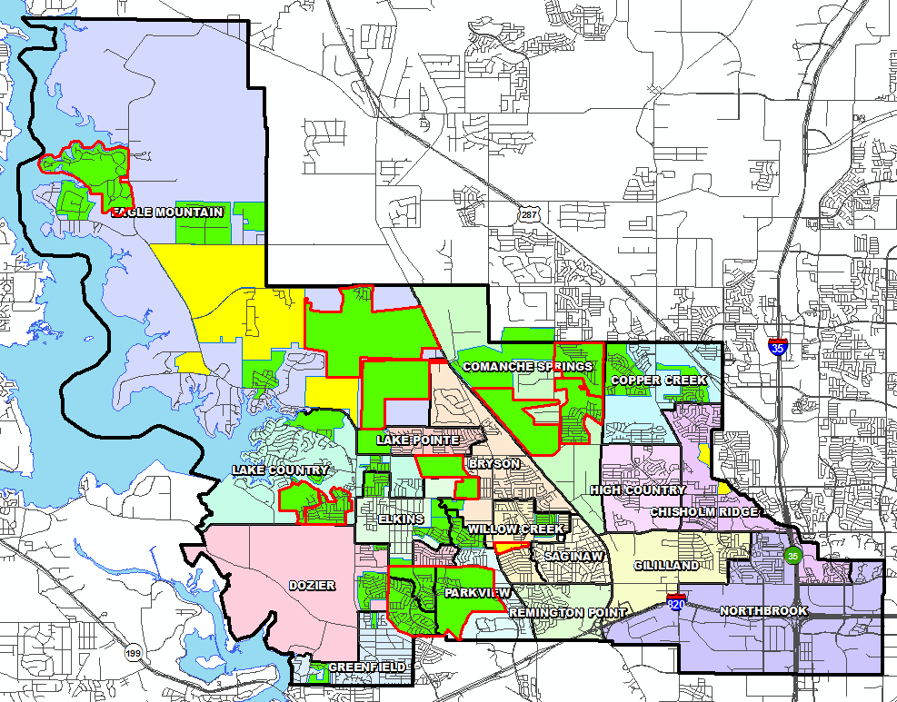
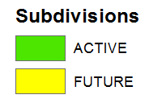

District Housing Overview
The district has 31 actively building subdivisions
Within EMS ISD there are 16 future subdivisions
Of these, groundwork is underway on 2,307 lots within 13 subdivisions

Slide 10
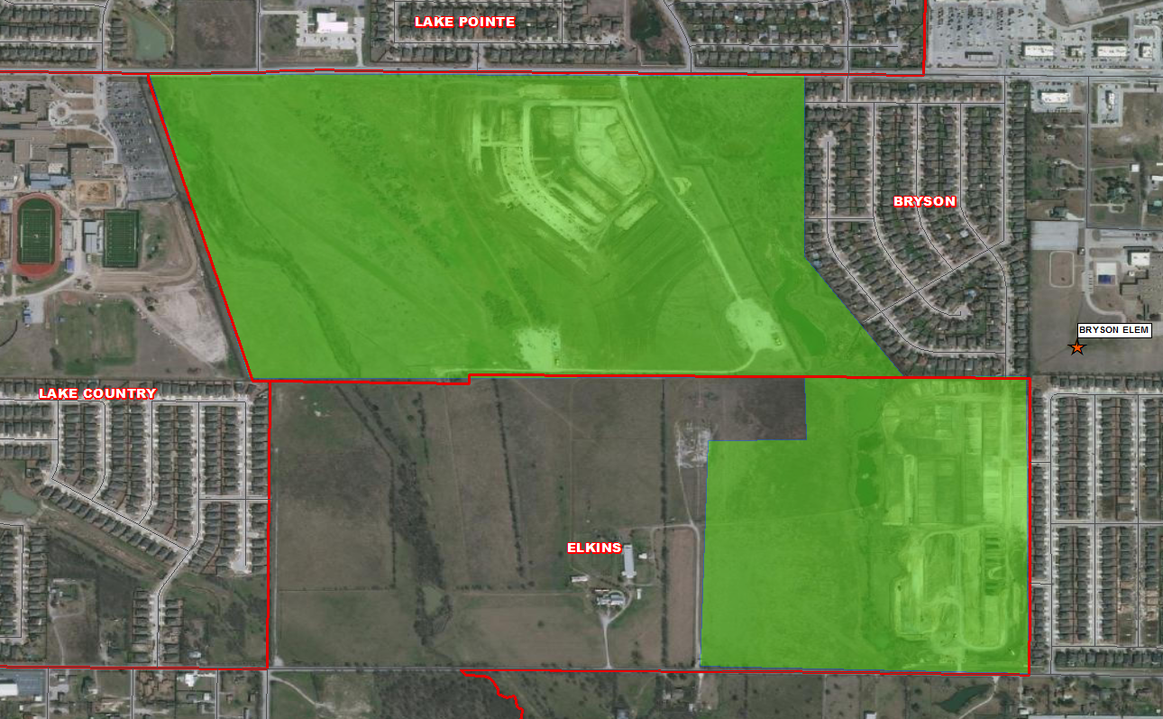
Residential Activity
Bailey Park
465 total lots
280 future lots
185 VDL
$300K-$375K
DR Horton Homes
Bryson Elementary Zone
Ranch at Duck Creek
361 total future lots
Groundwork is underway on all lots
Ashton Woods Homes
Elkins Elementary Zone

Slide 11
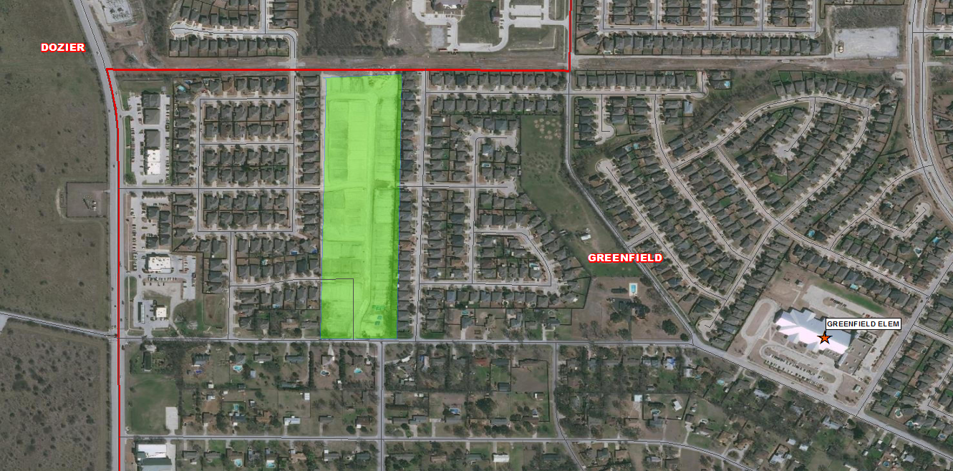
Residential Activity
Brookville Ranch
74 total lots
74 VDL
All lots delivered 2Q22
$400K-$500K
Greenfield Elementary Zone

Slide 12
One Year Forecast by Campus Comparison
 |  | Fall | 2021/22
Campus | Capacity | 2021/22 | Projections
HAFLEY DEVELOPMENT CENTER | 512 | 378 | 500
BRYSON ELEMENTARY | 692 | 572 | 536
CHISHOLM RIDGE ELEMENTARY | 758 | 647 | 661
COMANCHE SPRINGS ELEMENTARY | 736 | 547 | 580
COPPER CREEK ELEMENTARY | 758 | 547 | 464
DOZIER ELEMENTARY | 782 | 666 | 663
EAGLE MOUNTAIN ELEMENTARY | 670 | 417 | 431
ELKINS ELEMENTARY | 645 | 578 | 547
GILILLAND ELMENTARY | 564 | 503 | 472
GREENFIELD ELEMENTARY | 779 | 707 | 746
HIGH COUNTRY ELEMENTARY | 670 | 570 | 600
LAKE COUNTRY ELEMENTARY | 758 | 684 | 518
LAKE POINTE ELEMENTARY | 758 | 587 | 713
NORTHBROOK ELEMENTARY | 671 | 544 | 569
PARKVIEW ELEMENTARY | 693 | 557 | 540
REMINGTON POINT ELEMENTARY | 714 | 541 | 570
SAGINAW ELEMENTARY | 423 | 333 | 330
WILLOW CREEK ELEMENTARY | 662 | 598 | 598
ELEMENTARY TOTALS | 12,245 | 9,976 | 10,038
 |  | Fall | 2021/22
Campus | Capacity | 2021/22 | Projections
CREEKVIEW MIDDLE SCHOOL | 1,078 | 829 | 757
HIGHLAND MIDDLE SCHOOL | 1,050 | 757 | 811
PRAIRIE VISTA MIDDLE SCHOOL | 1,002 | 884 | 823
WAYSIDE MIDDLE SCHOOL | 1,002 | 1,055 | 998
WILLKIE MIDDLE SCHOOL | 1,002 | 701 | 755
MARINE CREEK MIDDLE SCHOOL | 1,200 | 1,070 | 1,071
MIDDLE SCHOOL TOTALS | 6,334 | 5,296 | 5,215
Middle School Percent Change |  | 1.46% | -0.31%
Middle School Absolute Change |  | 76 | -16
BOSWELL HIGH SCHOOL |  | 2,412 | 2,346
SAGINAW HIGH SCHOOL |  | 2,164 | 2,169
CHISHOLM TRAIL HIGH SCHOOL |  | 2,364 | 2,397
WATSON HIGH SCHOOL |  | 108 | 104
HIGH SCHOOL TOTALS |  | 7,048 | 7,016
High School Percent Change |  | 6.05% | 5.38%
High School Absolute Change |  | 402 | 358
TARRANT COUNTY JJAEP |  | 0 | 1
ALTERNATIVE DISCIPLINE SCHOOL |  | 13 | 11
ALTERNATIVE SCHOOL TOTALS |  | 13 | 12
DISTRICT TOTALS |  | 22,333 | 22,281

Slide 13
Ten Year Forecast by Grade Level
 | EE | PK | K | 1st | 2nd | 3rd | 4th | 5th | 6th | 7th | 8th | 9th | 10th | 11th | 12th | Total | Total Growth | Total %
2017/18 | 93 | 431 | 1,255 | 1,340 | 1,328 | 1,389 | 1,518 | 1,535 | 1,466 | 1,489 | 1,467 | 1,620 | 1,578 | 1,417 | 1,391 | 19,317
2018/19 | 110 | 413 | 1,357 | 1,396 | 1,400 | 1,398 | 1,498 | 1,639 | 1,645 | 1,597 | 1,546 | 1,621 | 1,632 | 1,491 | 1,311 | 20,054 | 737 | 3.82%
2019/20 | 112 | 398 | 1,413 | 1,465 | 1,464 | 1,454 | 1,490 | 1,601 | 1,742 | 1,776 | 1,671 | 1,777 | 1,655 | 1,591 | 1,415 | 21,024 | 970 | 4.84%
2020/21 | 117 | 342 | 1,358 | 1,462 | 1,522 | 1,497 | 1,493 | 1,566 | 1,637 | 1,809 | 1,778 | 1,817 | 1,749 | 1,619 | 1,479 | 21,245 | 221 | 1.05%
2021/22 | 69 | 533 | 1,477 | 1,576 | 1,594 | 1,599 | 1,589 | 1,539 | 1,687 | 1,739 | 1,871 | 2,088 | 1,850 | 1,667 | 1,455 | 22,333 | 1,088 | 5.12%
2022/23 | 58 | 657 | 1,570 | 1,653 | 1,670 | 1,702 | 1,709 | 1,704 | 1,709 | 1,812 | 1,826 | 2,074 | 2,101 | 1,761 | 1,543 | 23,549 | 1,216 | 5.44%
2023/24 | 61 | 683 | 1,643 | 1,738 | 1,748 | 1,748 | 1,798 | 1,808 | 1,894 | 1,821 | 1,919 | 2,029 | 2,061 | 2,004 | 1,633 | 24,589 | 1,040 | 4.42%
2024/25 | 63 | 712 | 1,718 | 1,791 | 1,828 | 1,855 | 1,854 | 1,898 | 1,955 | 2,006 | 1,898 | 2,110 | 2,017 | 1,973 | 1,852 | 25,530 | 941 | 3.83%
2025/26 | 65 | 721 | 1,770 | 1,885 | 1,869 | 1,920 | 1,939 | 1,941 | 2,042 | 2,048 | 2,068 | 2,089 | 2,096 | 1,926 | 1,822 | 26,201 | 671 | 2.63%
2026/27 | 68 | 746 | 1,848 | 1,947 | 1,977 | 1,971 | 2,030 | 2,020 | 2,065 | 2,136 | 2,104 | 2,272 | 2,067 | 2,004 | 1,778 | 27,032 | 831 | 3.17%
2027/28 | 71 | 767 | 1,919 | 2,035 | 2,028 | 2,066 | 2,063 | 2,115 | 2,112 | 2,159 | 2,186 | 2,311 | 2,253 | 1,977 | 1,852 | 27,913 | 881 | 3.26%
2028/29 | 73 | 782 | 1,973 | 2,089 | 2,111 | 2,107 | 2,157 | 2,147 | 2,215 | 2,214 | 2,199 | 2,365 | 2,263 | 2,152 | 1,826 | 28,673 | 760 | 2.72%
2029/30 | 76 | 806 | 2,053 | 2,137 | 2,155 | 2,185 | 2,179 | 2,233 | 2,249 | 2,318 | 2,257 | 2,402 | 2,332 | 2,164 | 1,987 | 29,532 | 858 | 2.99%
2030/31 | 77 | 816 | 2,088 | 2,211 | 2,201 | 2,234 | 2,265 | 2,250 | 2,341 | 2,352 | 2,364 | 2,460 | 2,366 | 2,229 | 1,999 | 30,253 | 722 | 2.44%
2031/32 | 79 | 832 | 2,142 | 2,259 | 2,271 | 2,264 | 2,315 | 2,329 | 2,357 | 2,452 | 2,398 | 2,570 | 2,419 | 2,263 | 2,059 | 31,008 | 754 | 2.49%
Yellow box = largest grade per year
Green box = second largest grade per year

Slide 14
Ten Year Forecast by Elementary Campus
 |  | Fall | ENROLLMENT PROJECTIONS
Campus | Capacity | 2021/22 | 2022/23 | 2023/24 | 2024/25 | 2025/26 | 2026/27 | 2027/28 | 2028/29 | 2029/30 | 2030/31 | 2031/32
HAFLEY DEVELOPMENT CENTER | 512 | 378 | 302 | 326 | 351 | 368 | 394 | 417 | 435 | 461 | 473 | 491
BRYSON ELEMENTARY | 692 | 572 | 610 | 623 | 643 | 656 | 678 | 698 | 716 | 721 | 729 | 732
CHISHOLM RIDGE ELEMENTARY | 758 | 647 | 705 | 708 | 728 | 752 | 758 | 773 | 786 | 797 | 806 | 823
COMANCHE SPRINGS ELEMENTARY | 736 | 547 | 687 | 820 | 970 | 1,067 | 1,179 | 1,259 | 1,279 | 1,291 | 1,289 | 1,290
COPPER CREEK ELEMENTARY | 758 | 547 | 610 | 675 | 697 | 709 | 750 | 754 | 742 | 743 | 734 | 733
DOZIER ELEMENTARY | 782 | 666 | 722 | 746 | 789 | 819 | 825 | 840 | 841 | 843 | 827 | 820
EAGLE MOUNTAIN ELEMENTARY | 670 | 417 | 515 | 597 | 699 | 824 | 976 | 1,187 | 1,425 | 1,632 | 1,884 | 2,116
ELKINS ELEMENTARY | 645 | 578 | 634 | 667 | 692 | 716 | 717 | 712 | 711 | 714 | 716 | 719
GILILLAND ELMENTARY | 564 | 503 | 504 | 513 | 509 | 521 | 527 | 520 | 511 | 506 | 501 | 495
GREENFIELD ELEMENTARY | 779 | 707 | 718 | 726 | 739 | 748 | 761 | 760 | 771 | 784 | 794 | 809
HIGH COUNTRY ELEMENTARY | 670 | 570 | 639 | 646 | 663 | 655 | 628 | 630 | 626 | 641 | 650 | 659
LAKE COUNTRY ELEMENTARY | 758 | 684 | 686 | 695 | 716 | 725 | 743 | 779 | 836 | 886 | 897 | 910
LAKE POINTE ELEMENTARY | 758 | 587 | 650 | 694 | 692 | 691 | 710 | 730 | 740 | 759 | 768 | 780
NORTHBROOK ELEMENTARY | 671 | 544 | 566 | 560 | 588 | 592 | 596 | 606 | 604 | 602 | 606 | 611
PARKVIEW ELEMENTARY | 693 | 557 | 634 | 663 | 682 | 715 | 758 | 774 | 784 | 778 | 785 | 797
REMINGTON POINT ELEMENTARY | 714 | 541 | 562 | 565 | 547 | 532 | 563 | 584 | 584 | 601 | 616 | 625
SAGINAW ELEMENTARY | 423 | 333 | 331 | 331 | 332 | 319 | 328 | 324 | 325 | 330 | 332 | 333
WILLOW CREEK ELEMENTARY | 662 | 598 | 647 | 673 | 682 | 700 | 715 | 716 | 724 | 733 | 735 | 748
ELEMENTARY TOTALS | 12,245 | 9,976 | 10,723 | 11,228 | 11,719 | 12,110 | 12,606 | 13,063 | 13,439 | 13,823 | 14,142 | 14,490
Elementary Percent Change |  | 6.62% | 7.49% | 4.71% | 4.37% | 3.34% | 4.10% | 3.63% | 2.88% | 2.85% | 2.31% | 2.46%
Elementary Absolute Change |  | 619 | 747 | 505 | 491 | 391 | 496 | 457 | 376 | 383 | 320 | 347
Yellow box = over 105% capacity
Green box = within 5% capacity

Slide 15
Ten Year Forecast by Secondary Campus
 |  | Fall | ENROLLMENT PROJECTIONS
Campus | Capacity | 2021/22 | 2022/23 | 2023/24 | 2024/25 | 2025/26 | 2026/27 | 2027/28 | 2028/29 | 2029/30 | 2030/31 | 2031/32
CREEKVIEW MIDDLE SCHOOL | 1,078 | 829 | 842 | 921 | 956 | 949 | 926 | 922 | 925 | 920 | 932 | 943
HIGHLAND MIDDLE SCHOOL | 1,050 | 757 | 777 | 845 | 897 | 890 | 915 | 928 | 957 | 921 | 924 | 906
PRAIRIE VISTA MIDDLE SCHOOL | 1,002 | 884 | 899 | 926 | 961 | 1,074 | 1,136 | 1,205 | 1,255 | 1,331 | 1,350 | 1,343
WAYSIDE MIDDLE SCHOOL | 1,002 | 1,055 | 1,066 | 1,094 | 1,108 | 1,211 | 1,318 | 1,372 | 1,432 | 1,535 | 1,676 | 1,813
WILLKIE MIDDLE SCHOOL | 1,002 | 701 | 743 | 816 | 842 | 894 | 899 | 942 | 956 | 965 | 1,000 | 1,023
MARINE CREEK MIDDLE SCHOOL | 1,200 | 1,070 | 1,019 | 1,031 | 1,094 | 1,139 | 1,110 | 1,087 | 1,102 | 1,151 | 1,174 | 1,178
MIDDLE SCHOOL TOTALS | 6,334 | 5,296 | 5,346 | 5,633 | 5,858 | 6,157 | 6,304 | 6,456 | 6,627 | 6,823 | 7,056 | 7,206
Middle School Percent Change |  | 1.46% | 0.94% | 5.37% | 3.99% | 5.10% | 2.39% | 2.41% | 2.65% | 2.96% | 3.41% | 2.13%
Middle School Absolute Change |  | 76 | 50 | 287 | 225 | 299 | 147 | 152 | 171 | 196 | 233 | 150
BOSWELL HIGH SCHOOL |  | 2,412 | 2,588 | 2,678 | 2,875 | 2,922 | 2,982 | 3,082 | 3,093 | 3,203 | 3,278 | 3,359
SAGINAW HIGH SCHOOL |  | 2,164 | 2,253 | 2,315 | 2,311 | 2,296 | 2,365 | 2,481 | 2,611 | 2,722 | 2,817 | 2,936
CHISHOLM TRAIL HIGH SCHOOL |  | 2,364 | 2,518 | 2,614 | 2,646 | 2,595 | 2,654 | 2,710 | 2,782 | 2,840 | 2,839 | 2,896
WATSON HIGH SCHOOL |  | 108 | 108 | 108 | 108 | 108 | 108 | 108 | 108 | 108 | 108 | 108
HIGH SCHOOL TOTALS |  | 7,048 | 7,467 | 7,715 | 7,940 | 7,921 | 8,109 | 8,381 | 8,594 | 8,873 | 9,042 | 9,299
High School Percent Change |  | 6.05% | 5.94% | 3.32% | 2.92% | -0.24% | 2.37% | 3.35% | 2.54% | 3.25% | 1.90% | 2.84%
High School Absolute Change |  | 402 | 419 | 248 | 225 | -19 | 188 | 272 | 213 | 279 | 169 | 257
TARRANT COUNTY JJAEP |  | 0 | 0 | 0 | 0 | 0 | 0 | 0 | 0 | 0 | 0 | 0
ALTERNATIVE DISCIPLINE SCHOOL |  | 13 | 13 | 13 | 13 | 13 | 13 | 13 | 13 | 13 | 13 | 13
ALTERNATIVE SCHOOL TOTALS |  | 13 | 13 | 13 | 13 | 13 | 13 | 13 | 13 | 13 | 13 | 13
DISTRICT TOTALS |  | 22,333 | 23,549 | 24,589 | 25,530 | 26,201 | 27,032 | 27,913 | 28,673 | 29,532 | 30,253 | 31,008
District Percent Change |  | 5.12% | 5.44% | 4.42% | 3.83% | 2.63% | 3.17% | 3.26% | 2.72% | 2.99% | 2.44% | 2.49%
District Absolute Change |  | 1,088 | 1,216 | 1,040 | 941 | 671 | 831 | 881 | 760 | 858 | 722 | 754
Yellow box = over 105% capacity
Green box = within 5% capacity

Slide 16
Key Takeaways
2Q22 new home starts is the highest quarter total since 2020
The district has 32 actively building subdivisions and 16 future subdivisions in the planning stages
Of these, groundwork is underway on more than 2,300 lots within 12 subdivisions
There are approx. 1,030 Multi-Family units under construction in the district
Enrollment growth for 2022-2023 school year will likely be between 800 to 900 due to softening housing market

